Slide 1
AI Driven Portfolio Optimizer
Faisal umar

Slide 2
Problem
Traditional optimizers ignore sentiment
Market psychology strongly influences short-term prices
Mean-variance optimization ignores sentiment
News strongly impacts stock movements

Slide 3
DATA
Prices: 3 years of daily OHLCV from Yahoo Finance
News data: scraped / sample financial headlines related to AAPL, MSFT, GOOGL, AMZN
Sentiment: VADER sentiment analysis

Slide 4
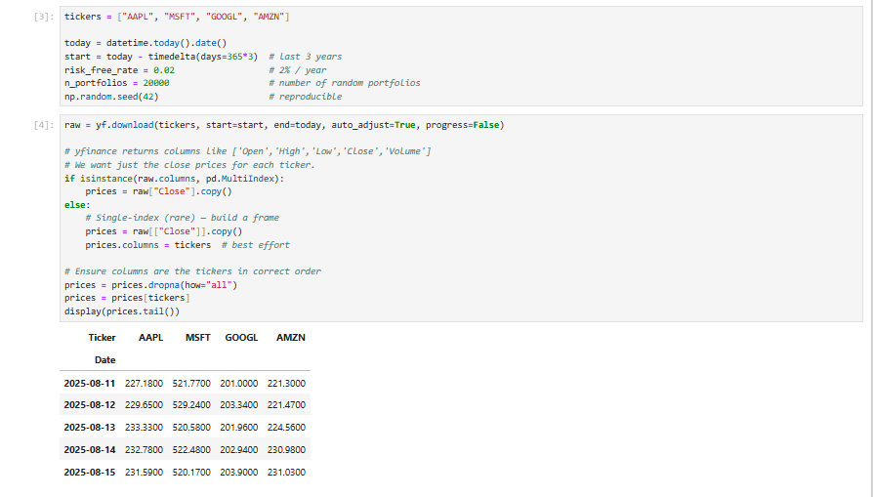

Slide 5
Method
yfinance (Adjusted Close → returns)
PyPortfolioOpt (mean-variance optimization)
VADER sentiment from sample headlines (CSV)
Weight adjustment logic (prototype, not fully tested)

Slide 6
Results
Annualized returns: AAPL 13.95%, MSFT 23.57%, GOOGL 23.08%, AMZN 22.17.
Baseline max-Sharpe: 23.42% expected return, 25.10% volatility, Sharpe 0.85.
Sentiment-adjusted portfolios were prototyped but not fully back tested. Preliminary evidence suggests that incorporating sentiment can reduce drawdowns in negative news cycles.

Slide 7
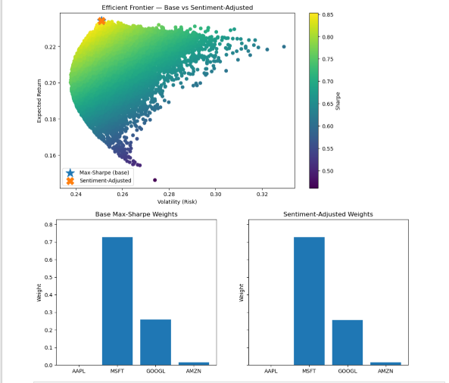

Slide 8
Future Work
Robust backtesting
FinBERT sentiment models
Include costs and rebalancing
Multi-asset expansion

